Slide 1
Project Requirements

Slide 2
Essential Elements
Data set(s)
Date preprocessing
Mining task(s)
Descriptive
Predictive
Evaluation
Objective measurements of performance
How good is the performance
Use different parameters to build model, use different data preprocessing parameters
Compare the performance with other mining method(s)
Visualization of the models/results if appropriate

Slide 3
Specific requirements
Descriptive tasks
Characteristics of some classes
Comparison of classes
Predictive tasks
Classification
Regression
Include at least two
Input transformations
Parameter tuning
Different mining methods

Slide 4
What to submit
Presentation
Report
Problem Description and Objectives
Dataset description and data mining tasks
Results and Discussions
Complete dataset(s) and R code
Everything needed to rerun your project

Slide 5
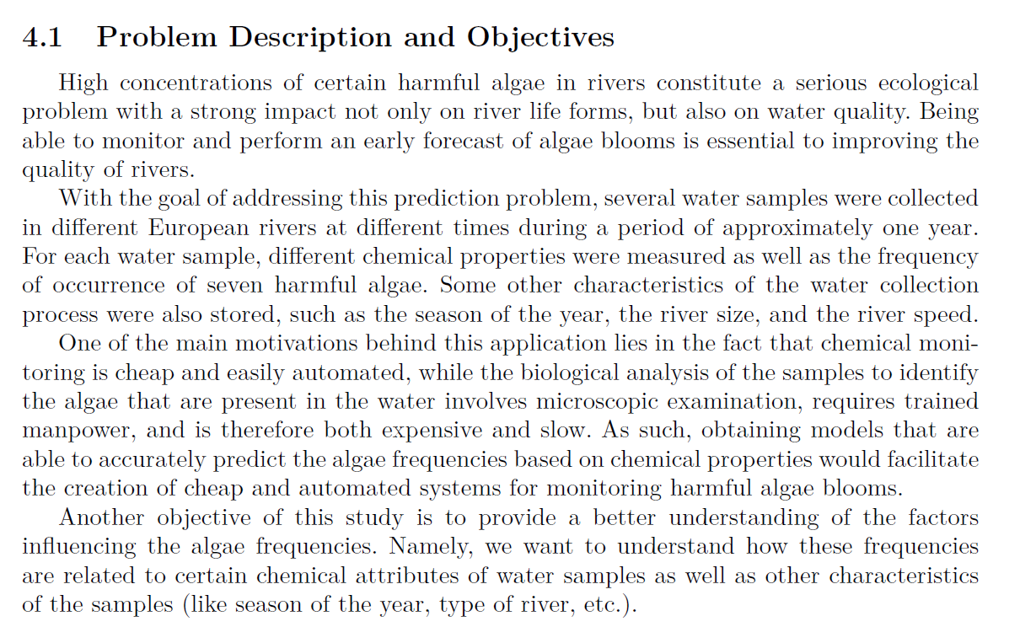
SAMPLE

Slide 6
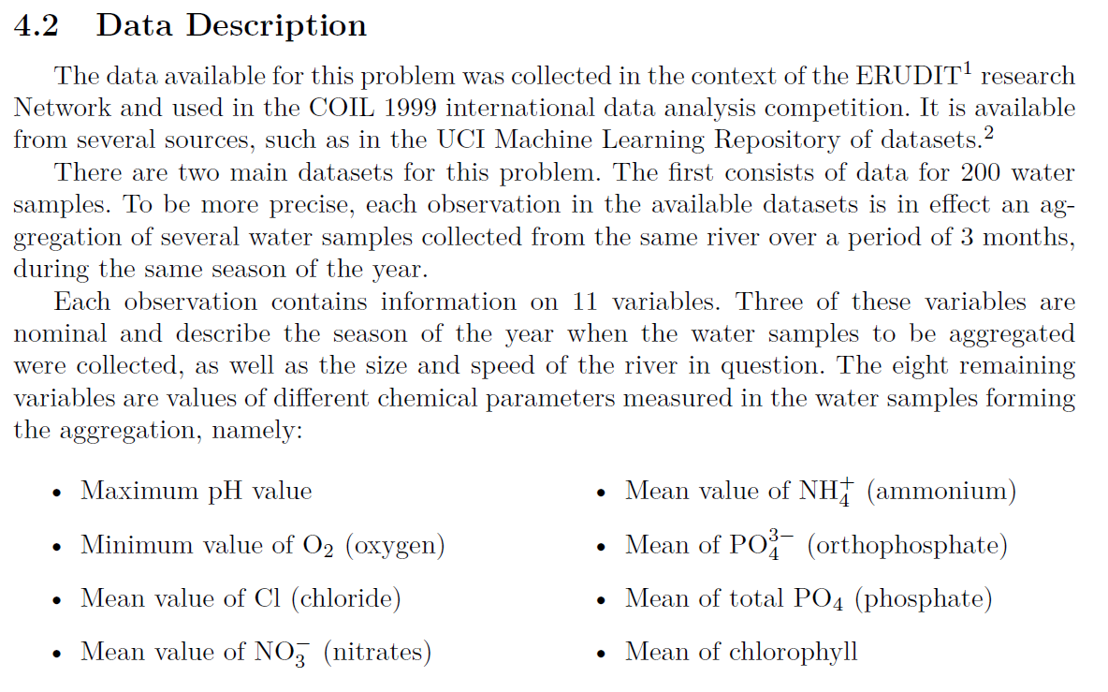
Dataset(s) and Data Mining Task
SAMPLE

Slide 7
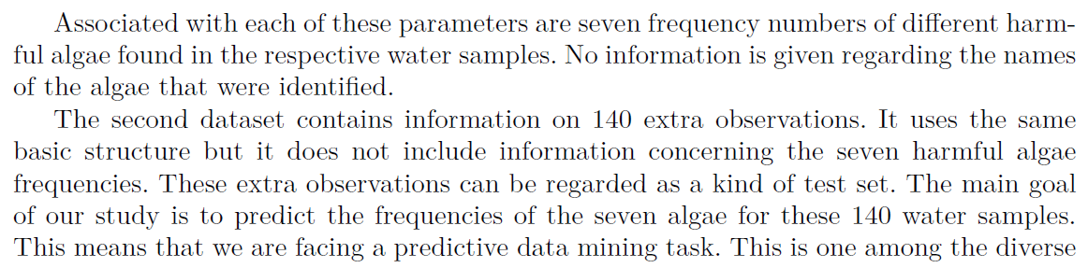
Dataset(s) and Data Mining Task

